Slide 1
Development of Plasma Feedback Control System in TST-2 Spherical Tokamak
Chang Tingzhi
2019. 8.27

Slide 2
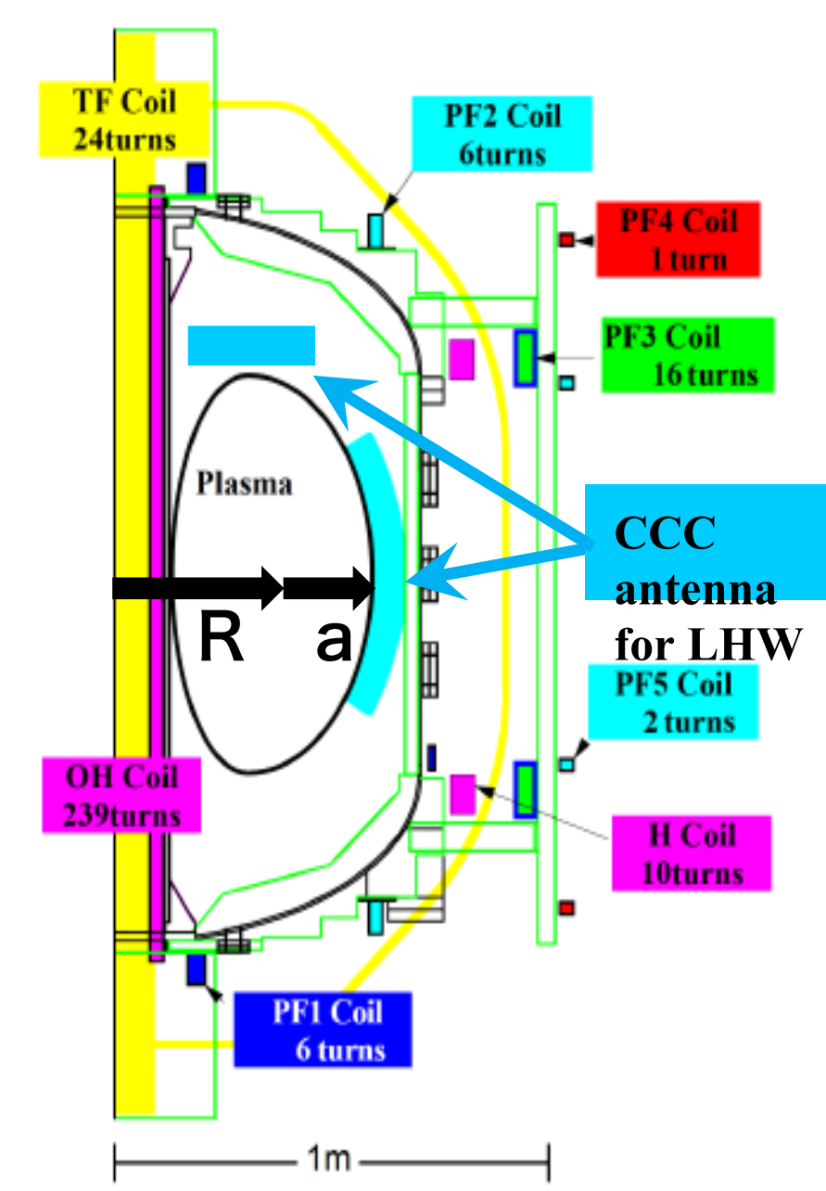
Introduction
In TST-2, PF3 and H coil are used to control the horizontal and vertical position of plasma
The current waveform of coils is controlled by sending preprogrammed signals to the IGBTs. The waveform is adjusted manually.

Slide 3
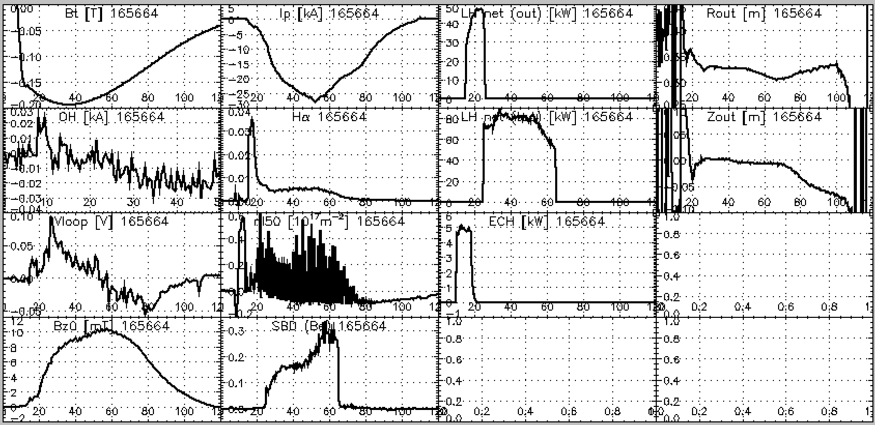
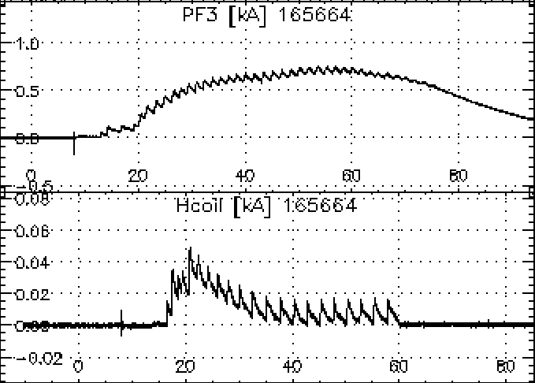
Introduction
The feedback control system serves to control the plasma position automatically according to a real-time calculation of plasma position, which helps to get a more stable plasma position especially during a long-lasting discharge

Slide 4
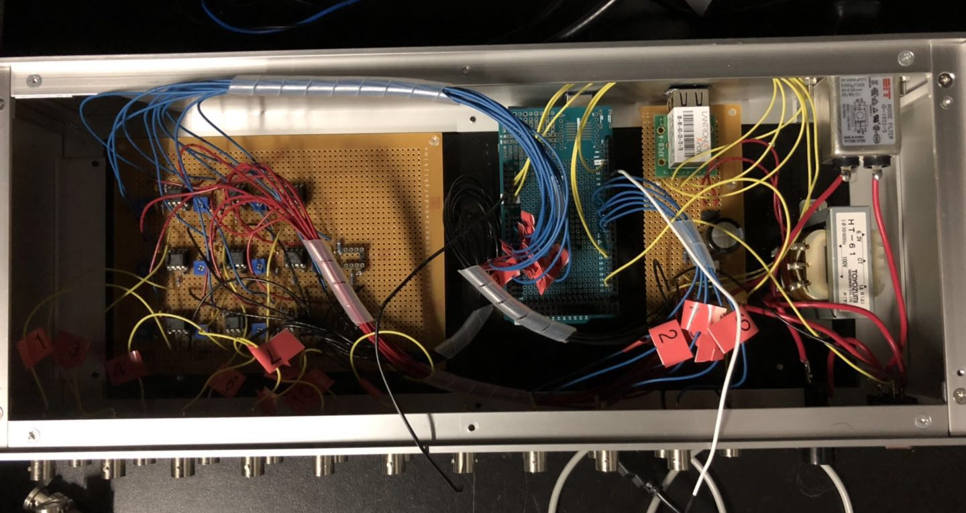
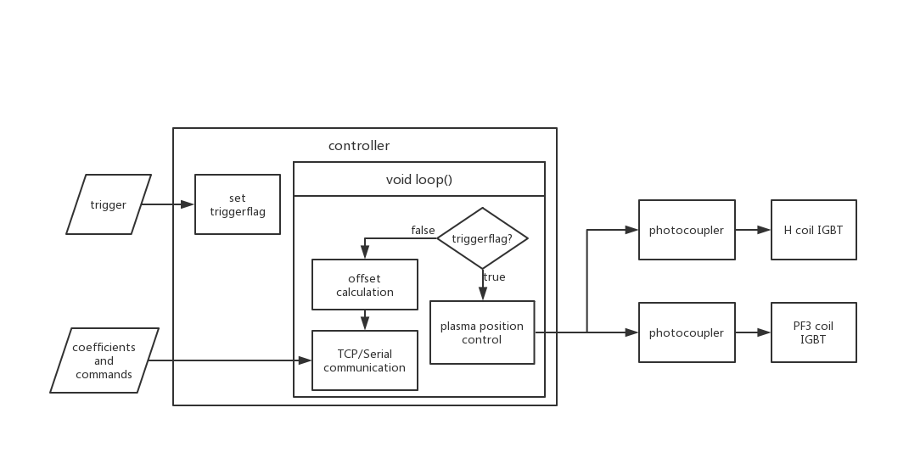
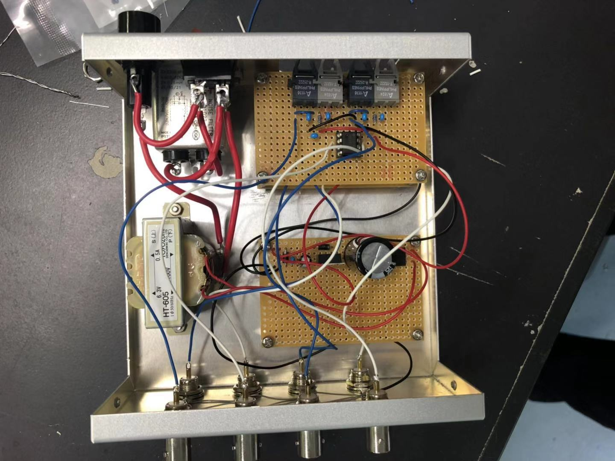
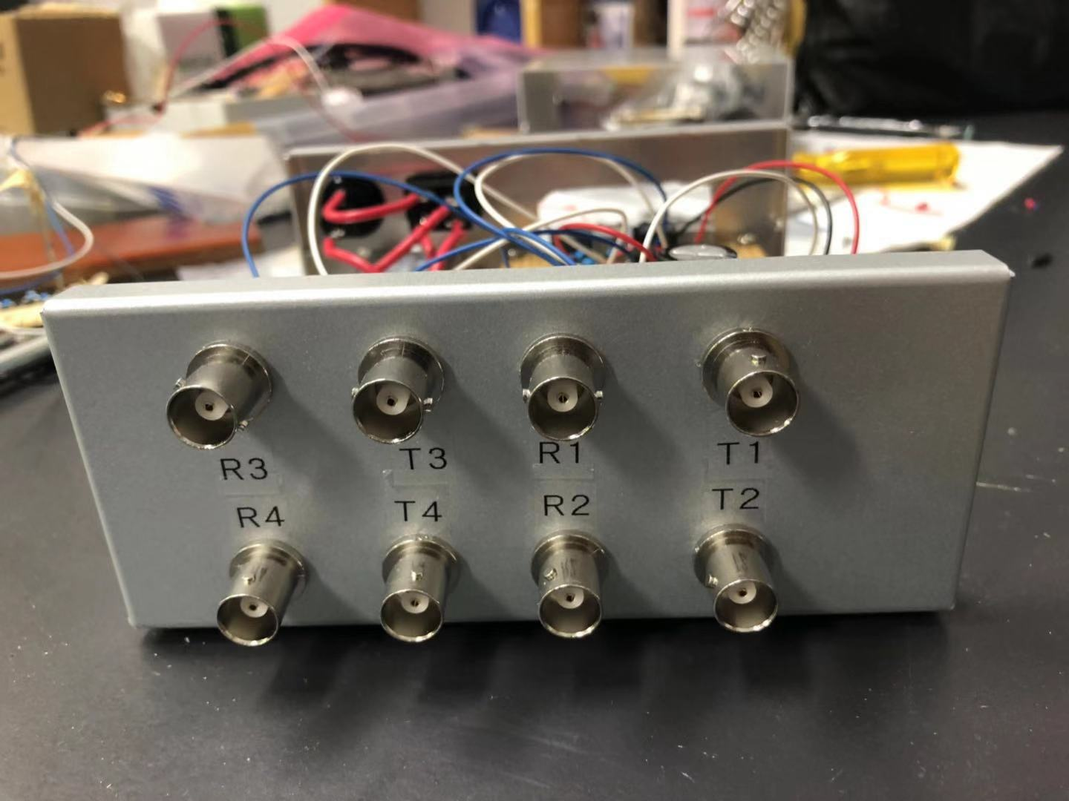
Sketch of Control System
In idle time, controller works to communicate and calculate signal offsets due to integrator offsets.
Preprogrammed waves and all calibration coefficients can be sent by TCP communication
When trigger comes in, trigger flag is set by interrupt, the controller will enter controlling process in next loop

Slide 5
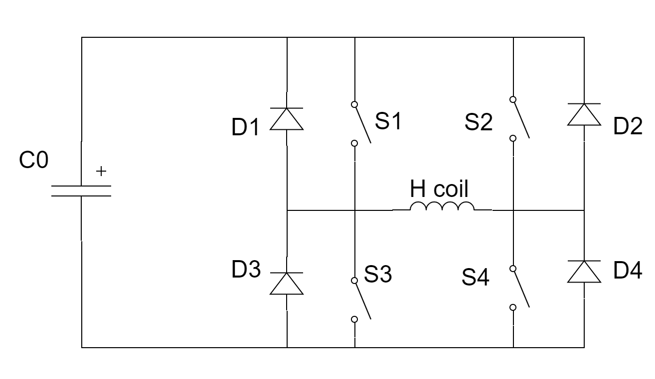
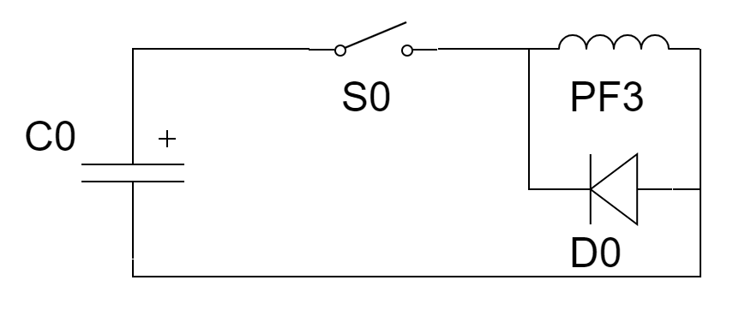
IGBT circuit
H coil control (current flows two direction: H bridge)
Group1: S1 & S4 (PWM)
Group2: S2 & S3 (PWM)
PF3 coil control
S0 (PWM)

Slide 6
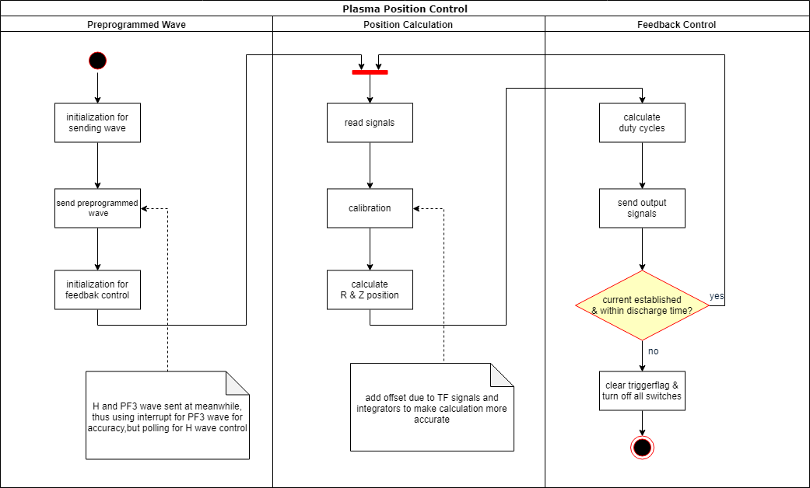
Position Control

Slide 7
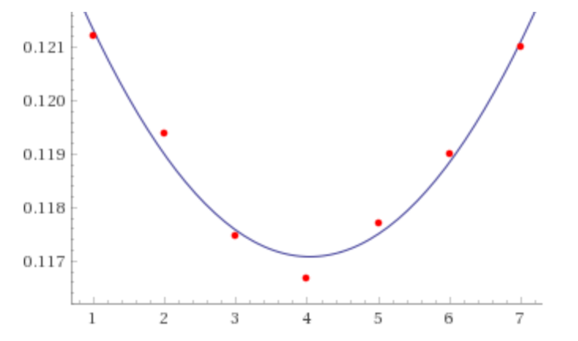
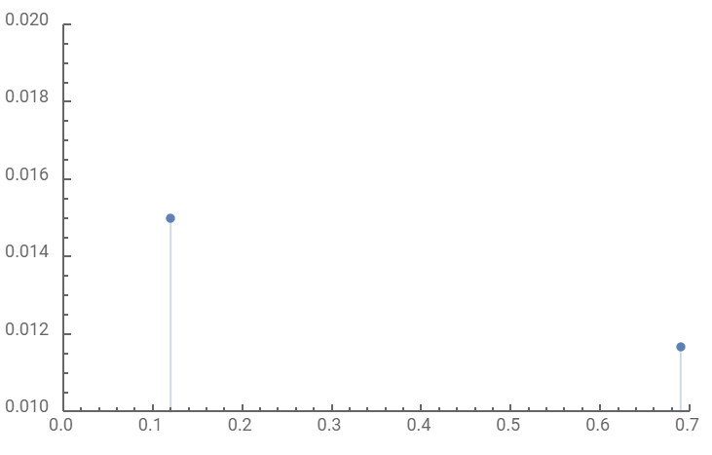

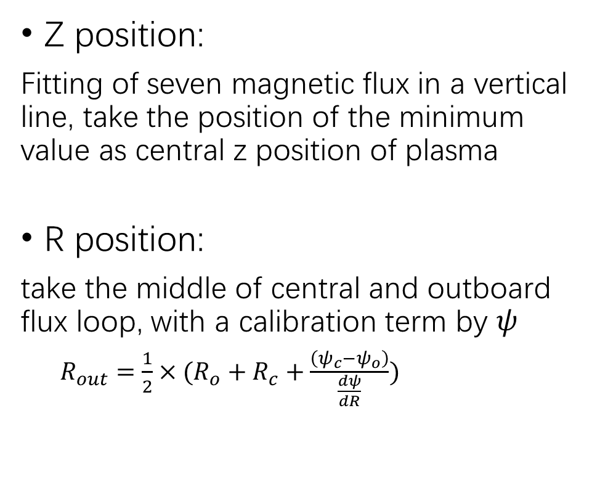



Plasma position calculation
Z position:
Fitting of seven magnetic flux in a vertical line, take the position of the minimum value as central z position of plasma
R position:
take the middle of central and outboard flux loop, with a calibration term by $ψ$
$R_{out}={\frac{1}{2}×(R}_{o}+R_{c}+\frac{\left(ψ_{c}−ψ_{o}\right)}{\frac{dψ}{dR}})$
$$Z_{out}$$
$$R_{C}$$
$$R_{out}$$
$$R_{o}$$

Slide 8
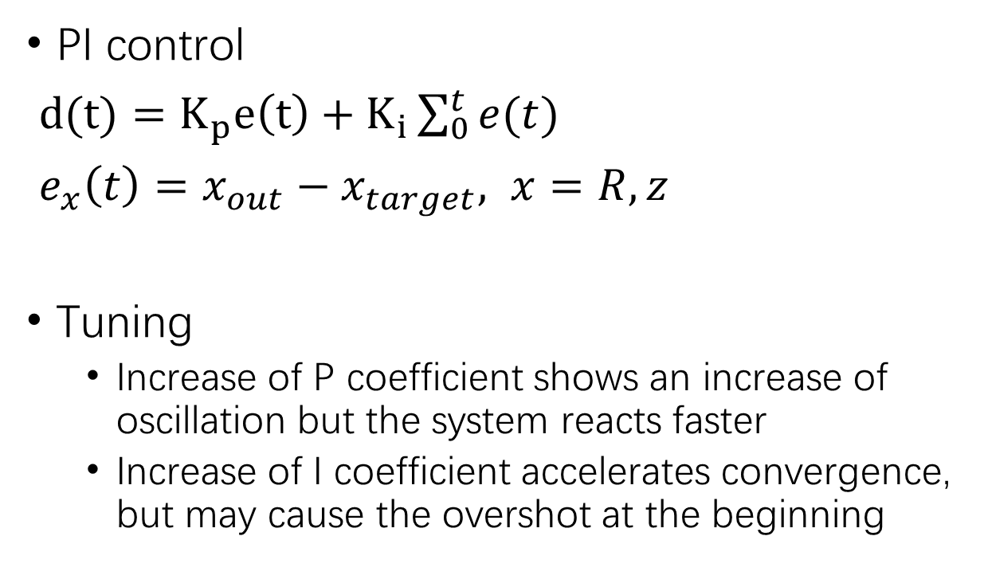
Feedback control
PI control
$d(t)=K_{p}e\left(t\right)+K_{i}\sum_{0}^{t}{e(t)}$
$e_{x}\left(t\right)=x_{out}−x_{target}, x=R,z$
Tuning
Increase of P coefficient shows an increase of oscillation but the system reacts faster
Increase of I coefficient accelerates convergence, but may cause the overshot at the beginning

Slide 9
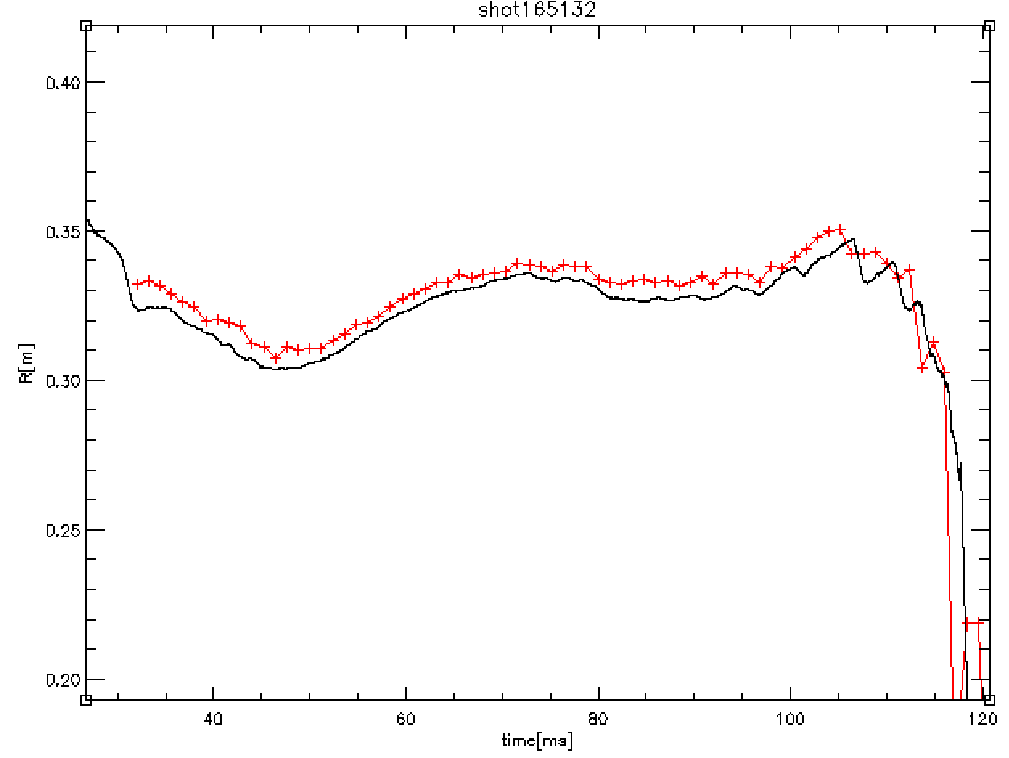
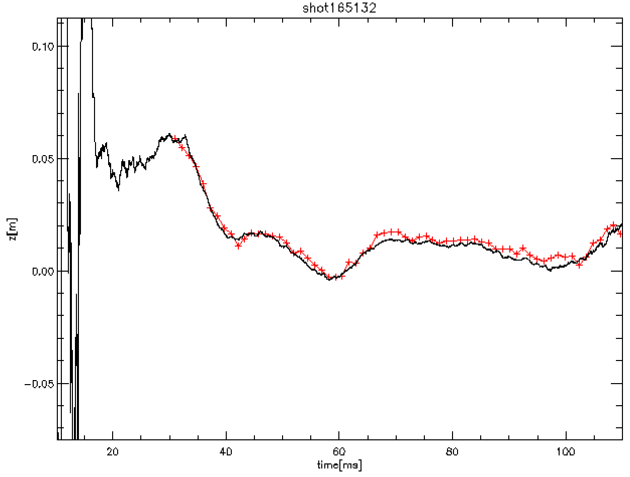
Calculation results (LH)
+++ controller results
A systematic error generally within 1cm (get better when applied noise reduce, TF offset calibration may not be accurate)
Z calculation is more accurate than R due to TF offset in R calculation

Slide 10
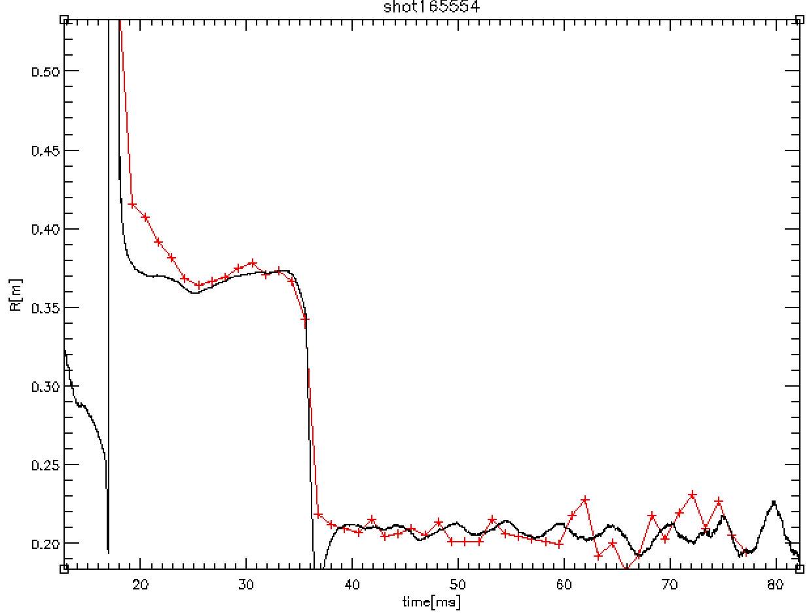
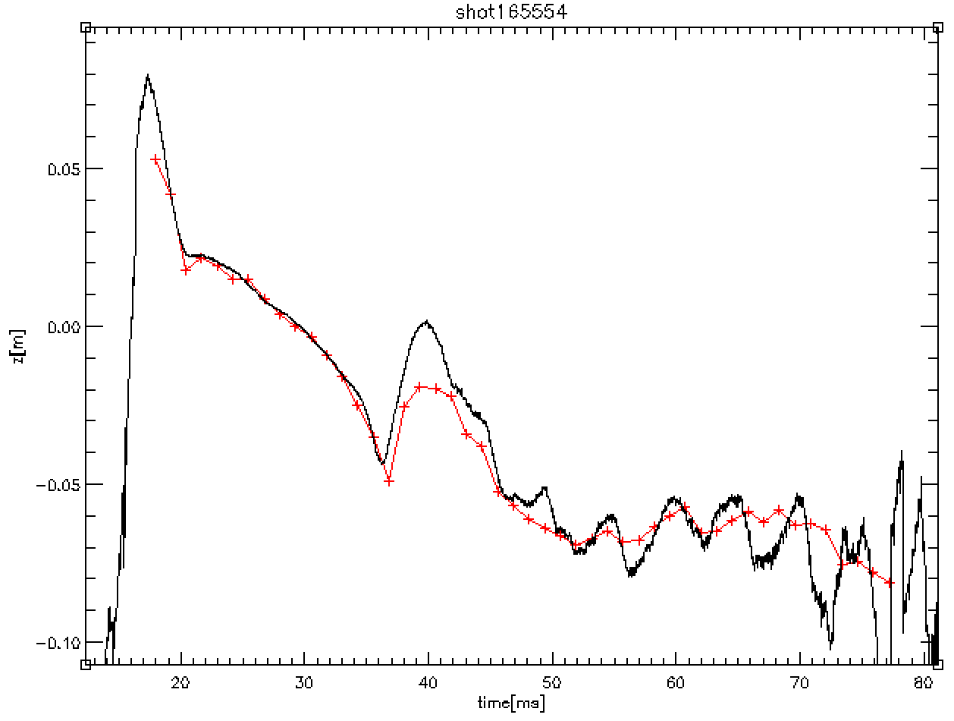
Calculation results (OH)
Improvement of TF calculation helps to improve R calculation
Calculation less accurate when signal changes quickly or signal is weak
Arduino calculation is slow, may not be able to control Ohmic discharge

Slide 11
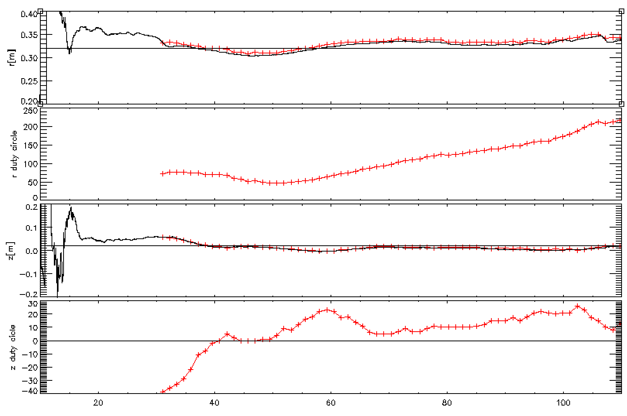
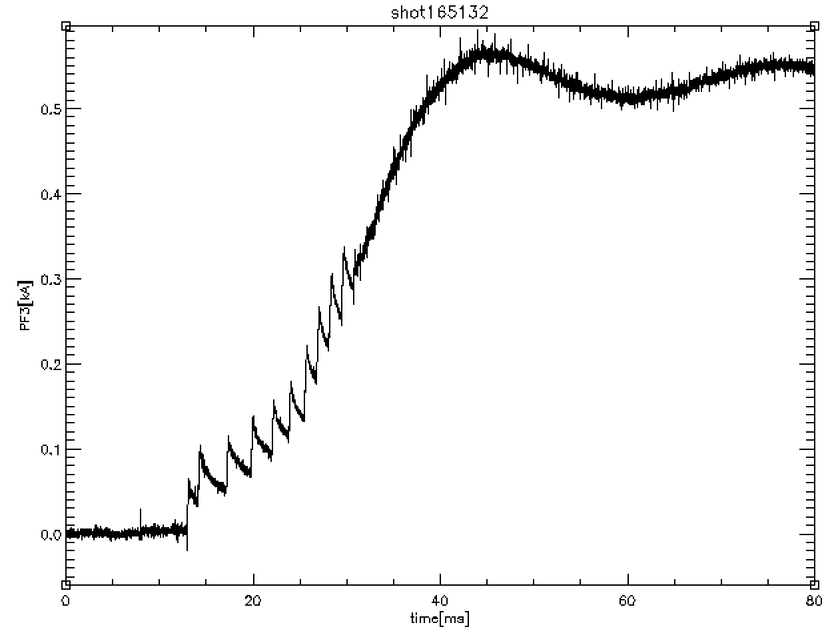
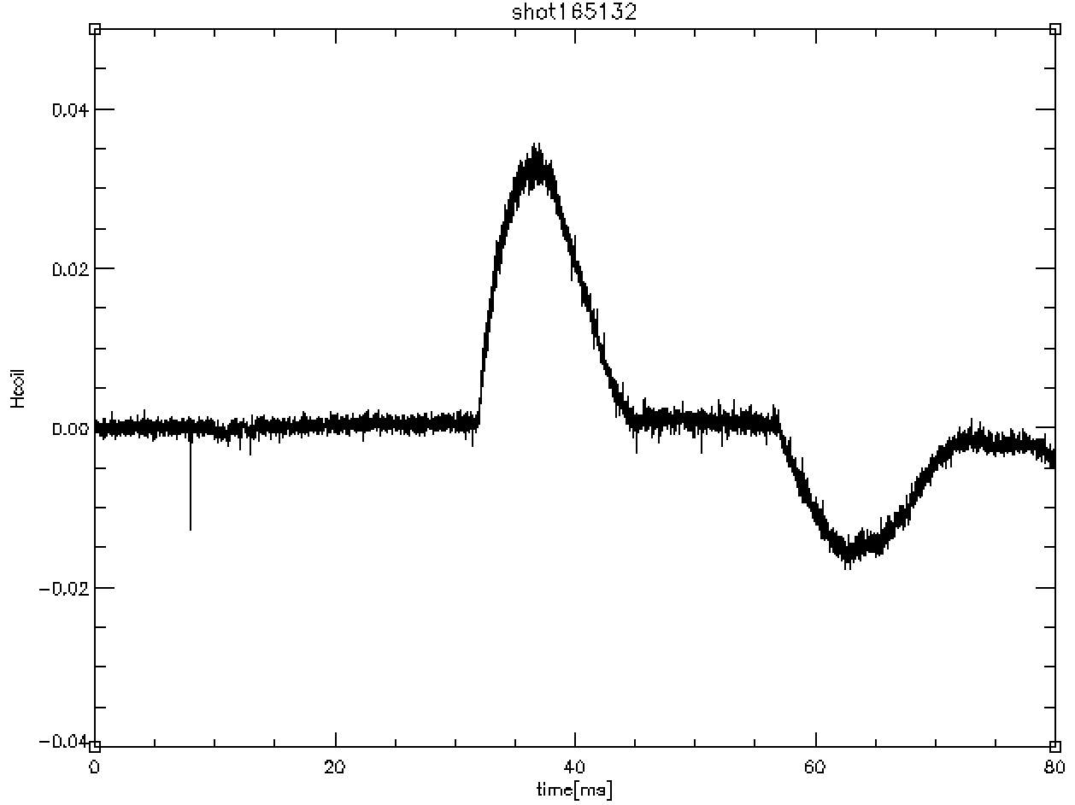
Controlling results (LH experiment)
Plasma position was controlled at the target with an maximum error of about 2 cm, stability was improved by adjusting PI parameters
The speed of Arduino is enough to control LH discharge

Slide 12
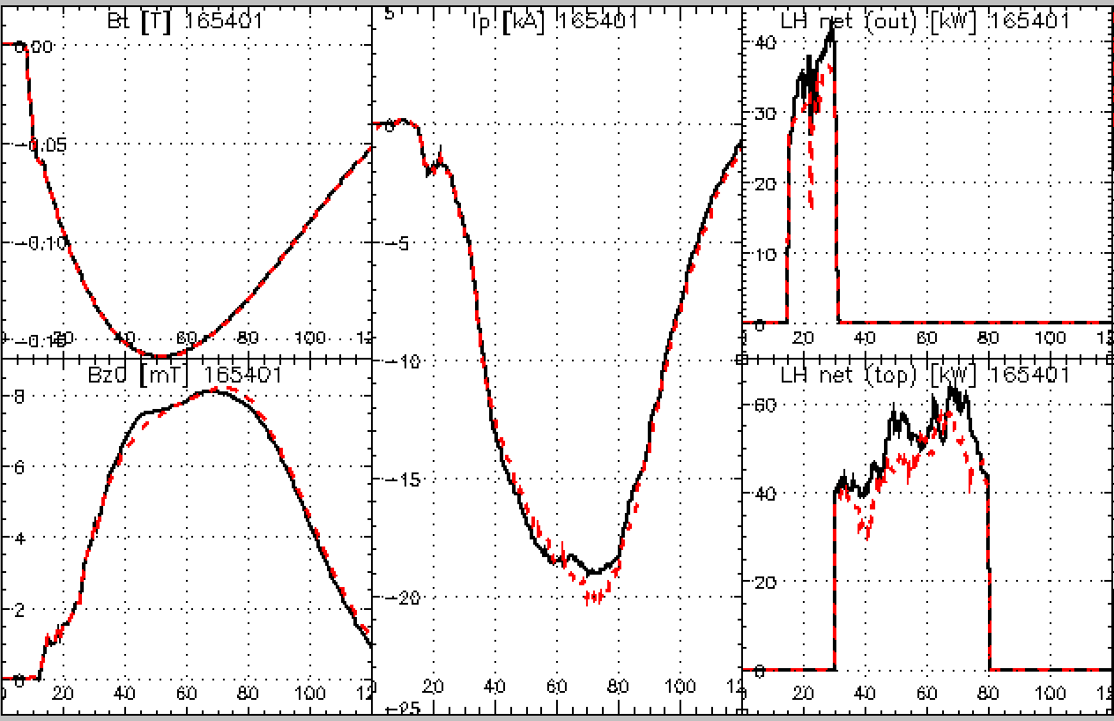
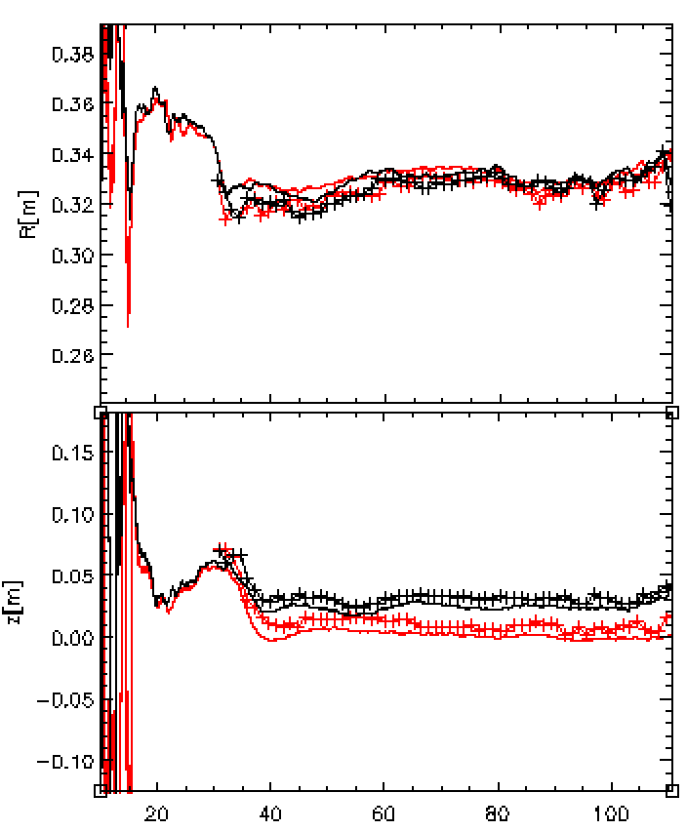
Parameter Scan: z target
z target [m]:
—— 0.04 —— 0.02
Changing z target didn’t show a big influence on plasma confinement

Slide 13
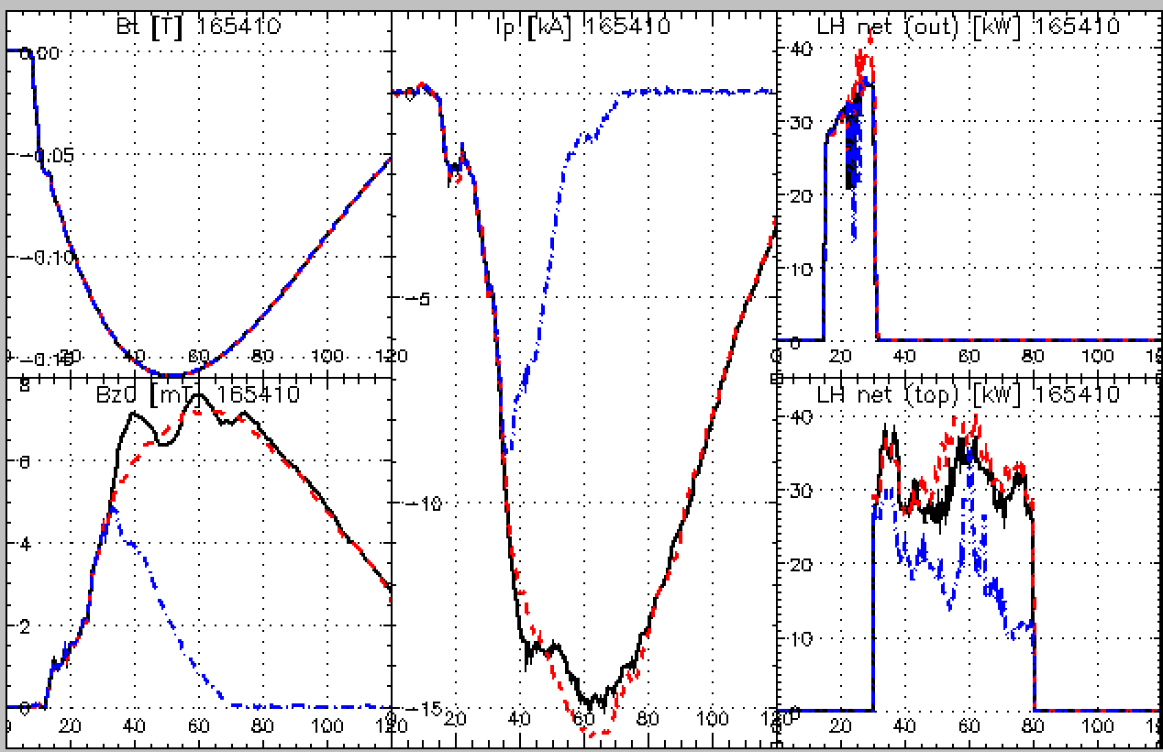
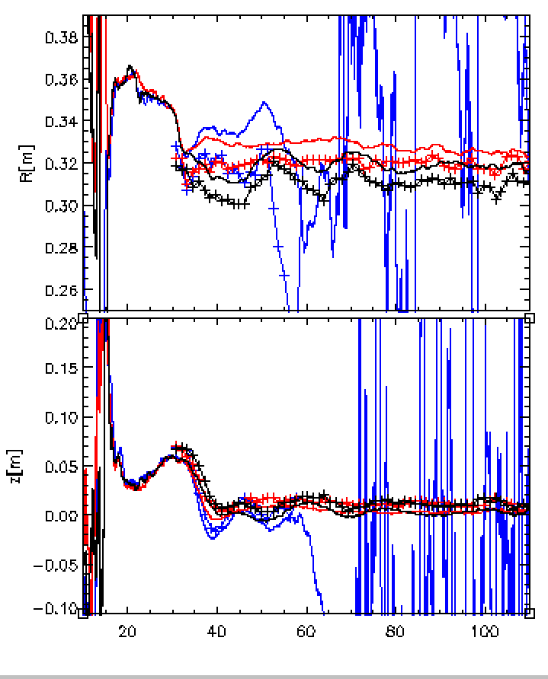
Parameter scan: R target
R target [m]:
—— 0.31 —— 0.32 —— 0.33
Plasma showed a sensitive reaction of R position, when R target is bigger, plasma current is more easy to break up (when the target is set to 0.33), optimum R target is around 0.32m,
less oscillation helps to improve current

Slide 14
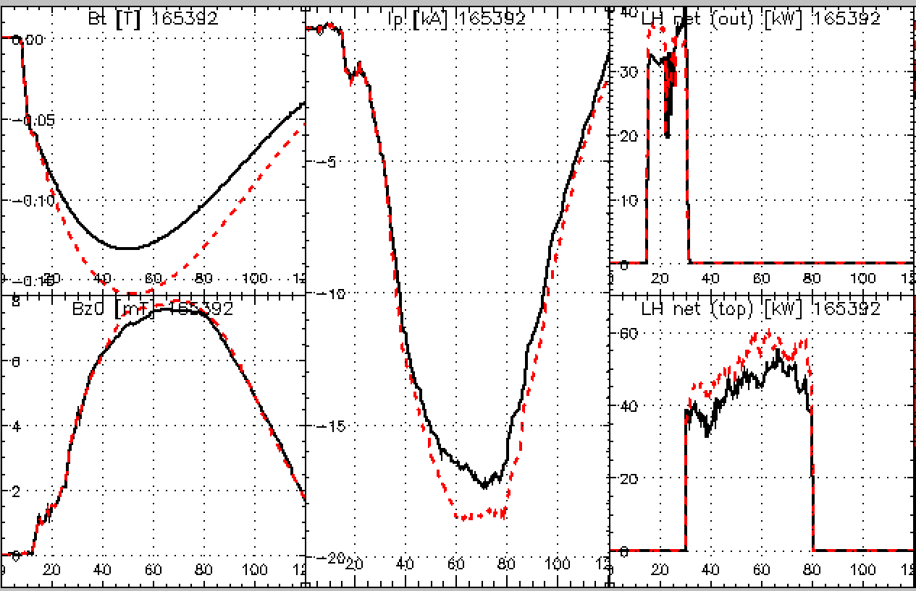
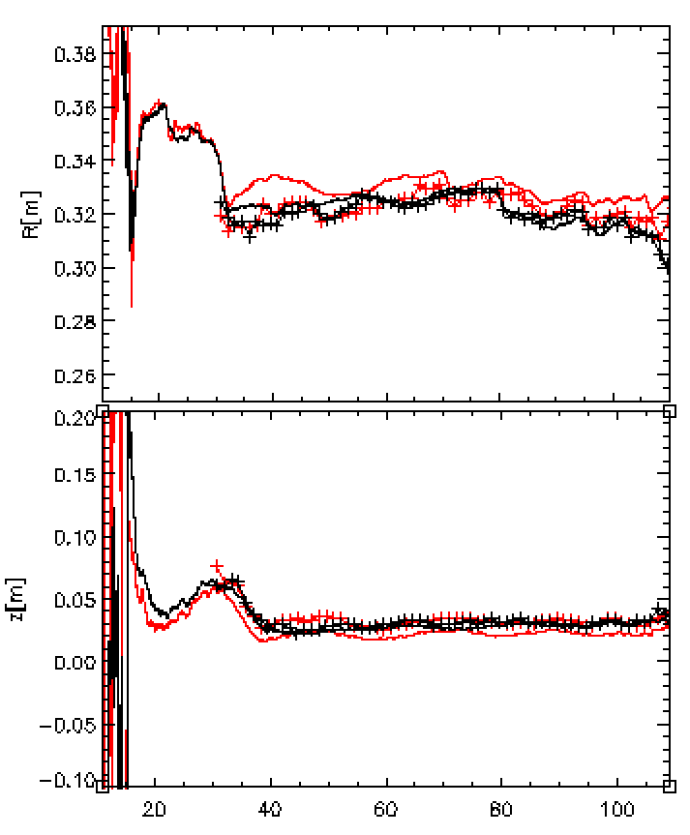
Parameter scan: B_t
Bigger toroidal field shows improvement of confinement

Slide 15
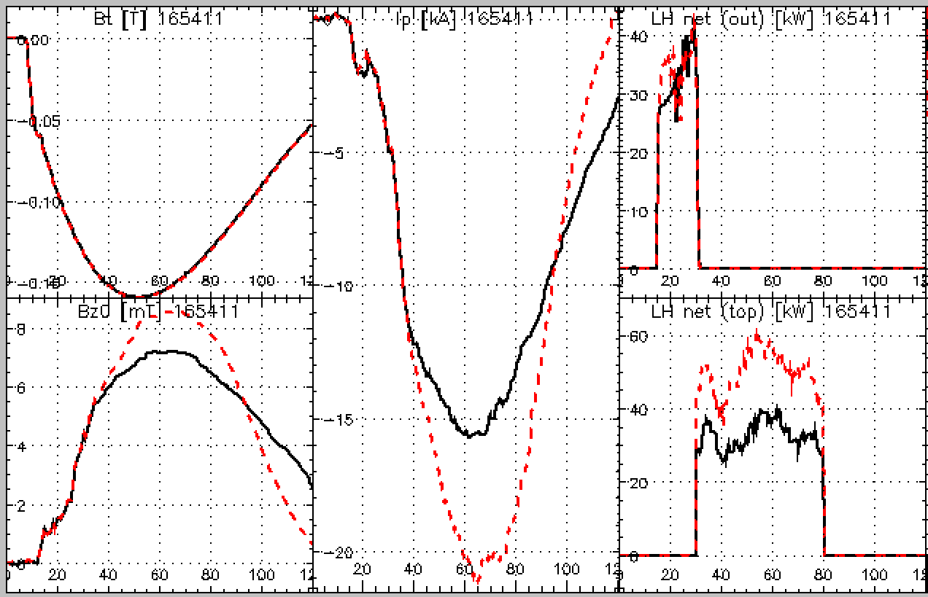
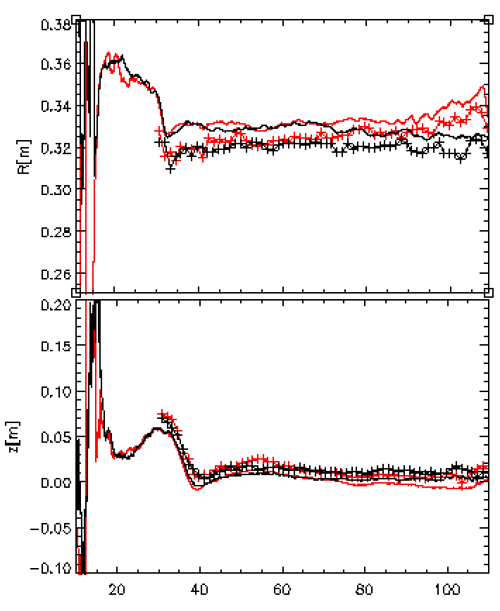
Parameter scan: LH power
bigger LH power drives bigger current, but the current dropped faster

Slide 16
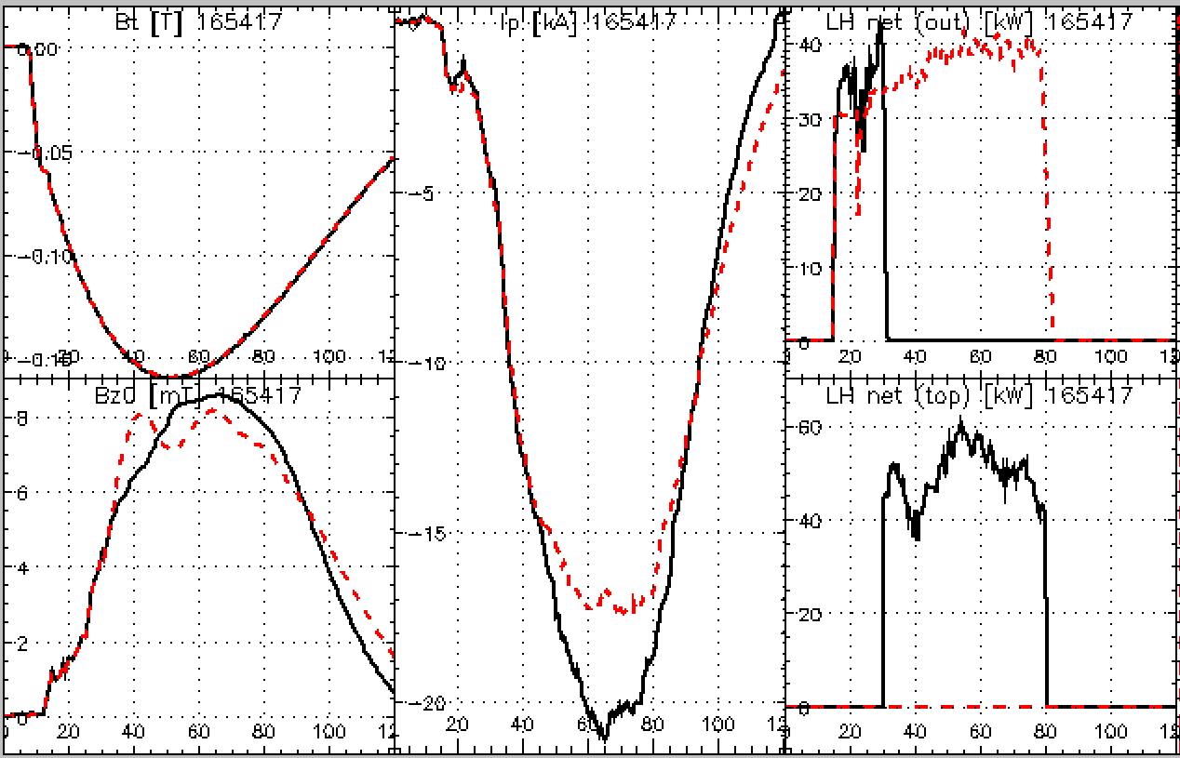
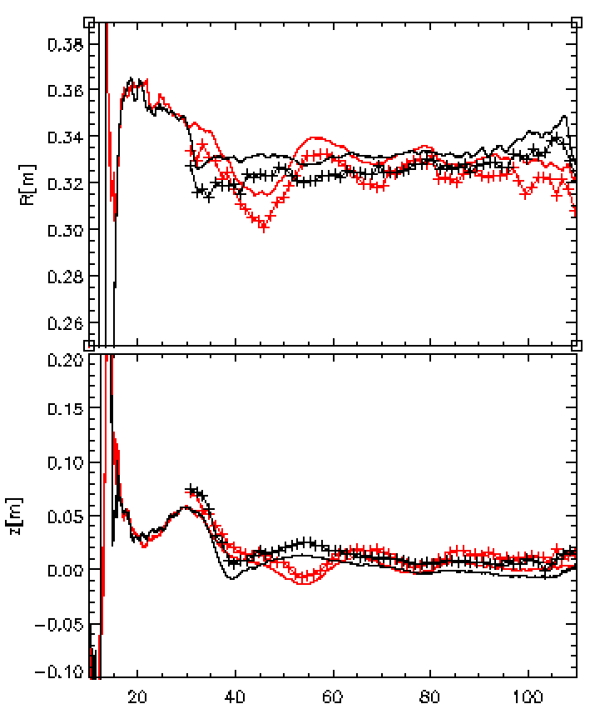
Parameter scan: antenna
Top launched antenna is able to drive bigger plasma current (after the current established), the feedback control is sensitive to initial position

Slide 17
Conclusion
A plasma feedback control system was developed in TST-2 successfully to help control the plasma position in two dimensions, R & Z position can be maintained automatically by the controller
Calculation of plasma position in R direction is with an error of 1cm but can be improved with more accurate TF offset. Calculation of Z position is better than R, within an error of about 0.5 cm
Controlling on LH experiment shows a stable control of plasma position within an error of 2 cm to the target in both direction
Parameter scan shows an optimum R position around 0.32m in LH discharge, the increase of toroidal field, LH power, and using of top launched antenna helps to increase plasma current

Slide 18
Future work
The convergence is now is very slow and showed some oscillations, which is sensitive to the initial position more experiment is needed to adjust the P & I parameters
The processing speed of controller is enough for LH experiment but may not be enough for OH experiment. Therefore we consider to use more powerful controller like FPGAs

